Slide 1
Software Quality Assurance Planning

Slide 2
The SQA plan
The SQA plan provides a road map for implementing software quality assurance.
An outline for SQA plans by IEEE [IEEE94]
Basic items:
purpose of plan and its scope
-Reference Documents
Provide the complete list of document referenced to develop SQAP
management
organization structure, SQA tasks, their placement in the
process
roles and responsibilities related to product quality

Slide 3
The SQA plan
Documentation
project documents, models, technical documents, user documents.
standards and practices
appropriate reviews and audits to check documents
Test
test plan and procedure
problem reporting, and correction actions
tools
code control
way to protect or ensure the validity of completed code.
media control
secure media for software storage and retrieval
maintenance, and retention
training
risk management

Slide 4
Quality Goal methodology
Compile the quality goal from each interested party
A quality/reliability engineering analysis must be performed to ascertain the effects of the various quality attributes.
The end result of this process will be the creation of prioritized list of the desired and agreed on quality goals.

Slide 5
Consideration for quality goals establishment
System characteristics
functionality
performance
constraints
technologies innovativeness
technological and managerial risk
Trade-offs
Quality perceptions
All staff and users involved with the system
perception may be attained via s survey.
4) Quality functions
auditing
Methodology
Analyzing
Reporting
5) Training
Testing
verification & validation
Tooling
auditing
analyzing
QM planning

Slide 6
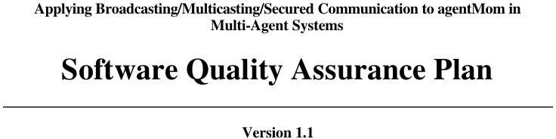

Slide 7
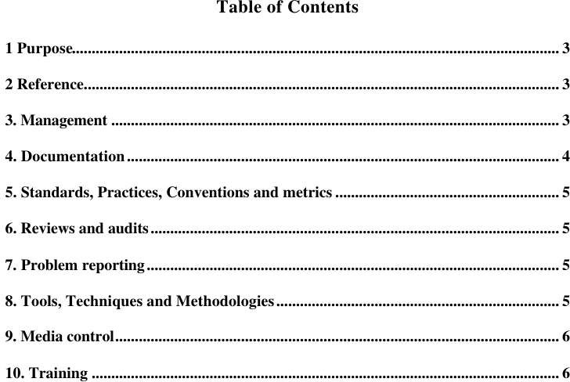

Slide 8
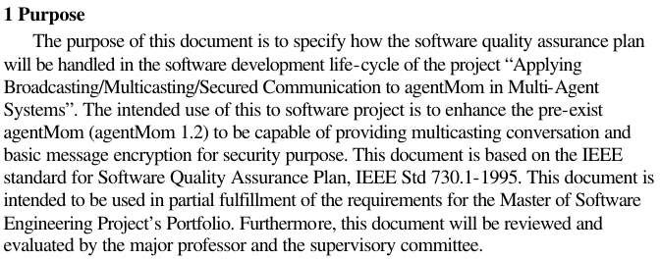

Slide 9
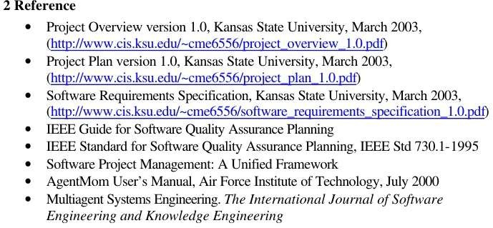

Slide 10
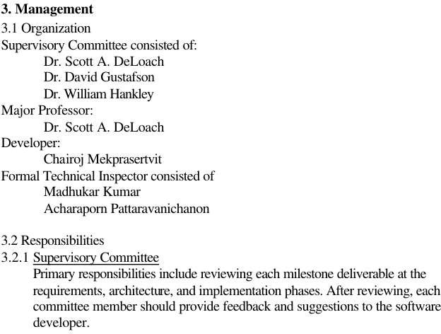

Slide 11
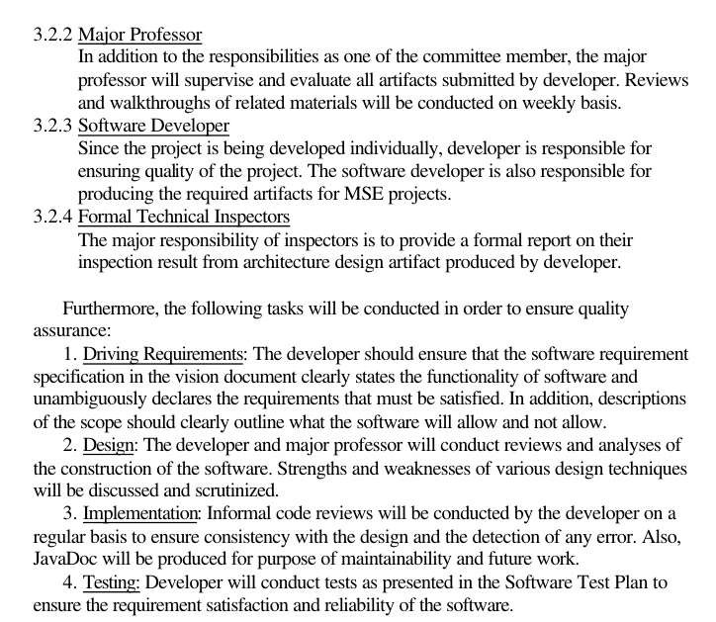

Slide 12
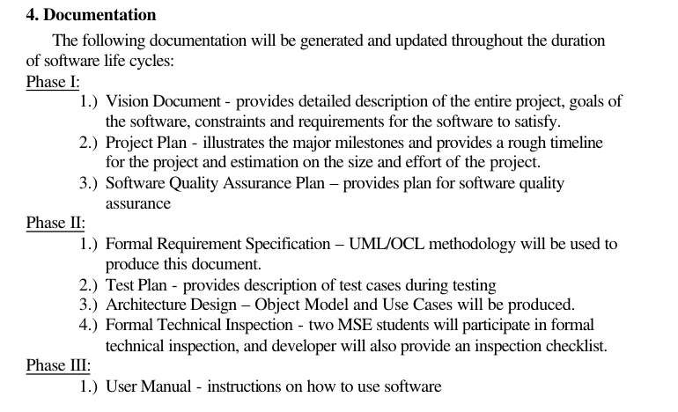

Slide 13
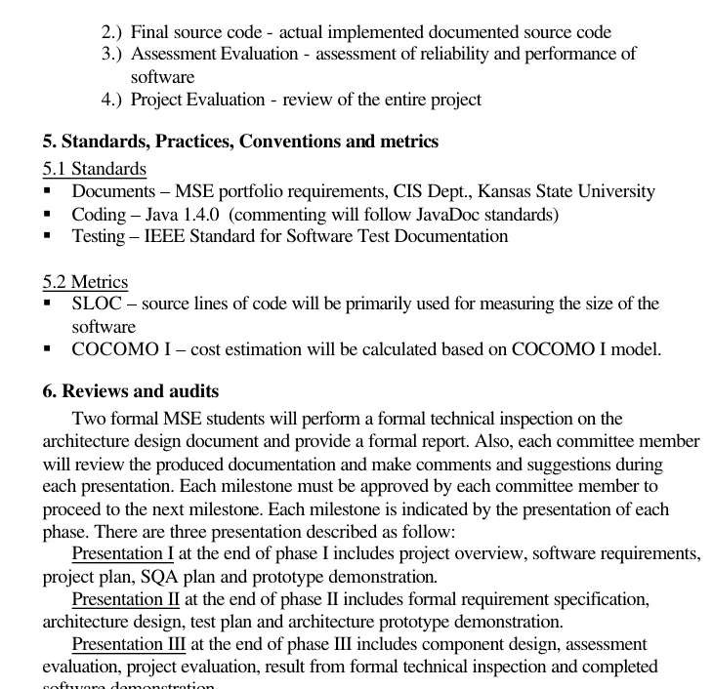

Slide 14
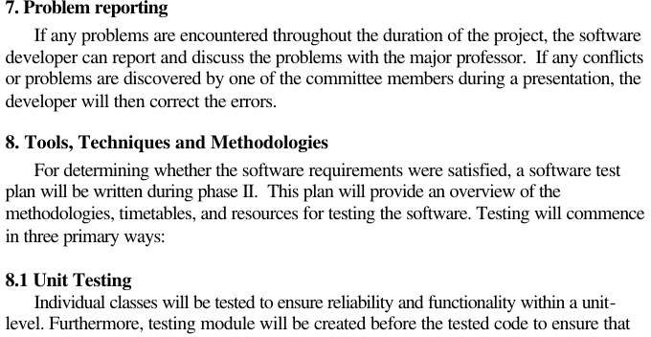

Slide 15
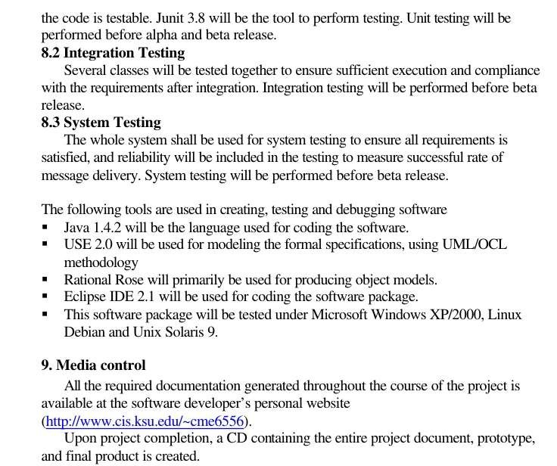

Slide 16
